Slide 1

Capstone Project Hotel Booking Analysis

Slide 2

TEAM MEMBERS: 1.Mr.Pratik Ghodke 2.Ms.Madhuri Bonela
This Photo by Unknown Author is licensed under CC BY

Slide 3

Hotel Booking Analysis
Hotel booking analysis is used to define patterns and to predict the future bookings of hotels by using time sequence in data. Where the data is used to predict future trends and what factors can even increase hotel bookings .
We can tackle future prediction from the following analysis :
1.The number of cancellations.
2.Country wise bookings.
3.Type of rooms preferred by people.
4.The type of hotels preferred by people.
5.Types of customers and their likes.
All the above factors can be analysed and information can be
retrieve so that we can apply them on business to increase
profit and for long-run business.

Slide 4
Feature descriptions

Slide 5
Feature descriptions

Slide 6
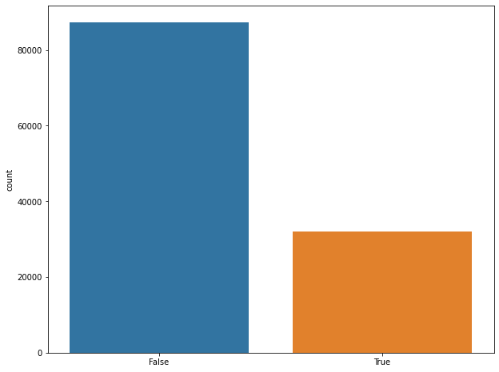
Data Cleaning
Checking for the duplicate rows
So we have 31994 duplicate rows in our data. So we will drop the duplicate rows from our data
dropping the duplicate rows
DF= DF.drop_duplicates()
DF.shape #data set reduced
(87396, 32)
we have to drop duplicate rows in dataset as they
are less reliable and they cannot be used to retrive
Useful information from datasets they are eventually
dropped.
The final dataset we got was 87396 features and 32 columns .

Slide 7
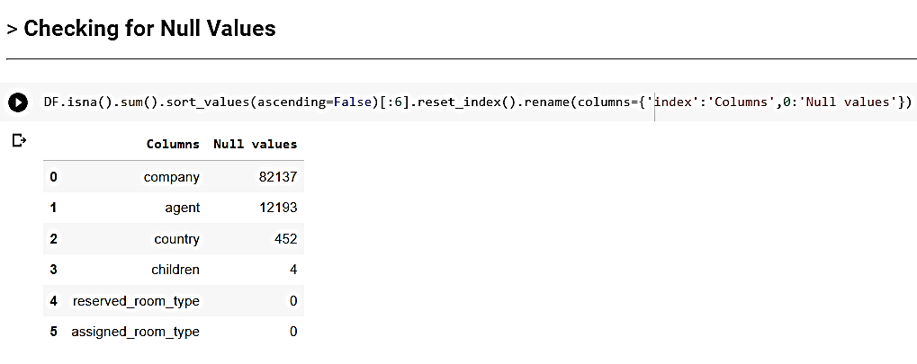
Checking for Null Values
1.for company and agent I will fill the Missing values with Zero (0) 2.for country we will fill Missing values with object 'others'. 3.AS the count of missing values in Children Column is only 4, so we can replace with 0 considering no children's.

Slide 8
EDA (Exploratory Data Analysis)
1)Hotel Type 2)Cancelled bookings 3)Average Daily Rate (ADR) :- dividing the sum of all lodging transactions by the total number of staying nights 4)Now lets check the arrival date by months 5)Market Segment 6)Year of arrival date 7)Customer Type 8)Distribution Channel 9)Repeated Guest 10) which are the months of highest and least occupation? 11)Which is the most reserved room type?

Slide 9
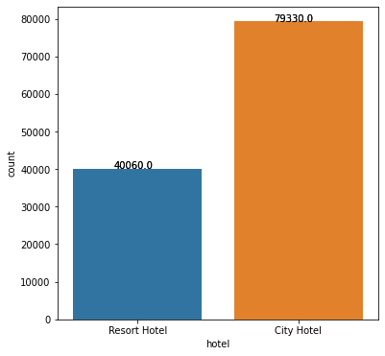
EDA (Exploratory Data Analysis)
1) Hotel Type:
Type of hotel preferred by most of the customers is very important factor in hotel booking analysis.
From the figure we can conclude that city hotels are preferred by most of the customers compared to resort hotels
where city hotel bookings counts are 79330 and resort type bookings are of 40060.

Slide 10
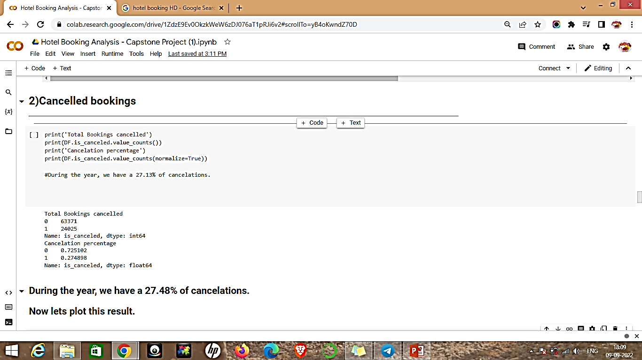
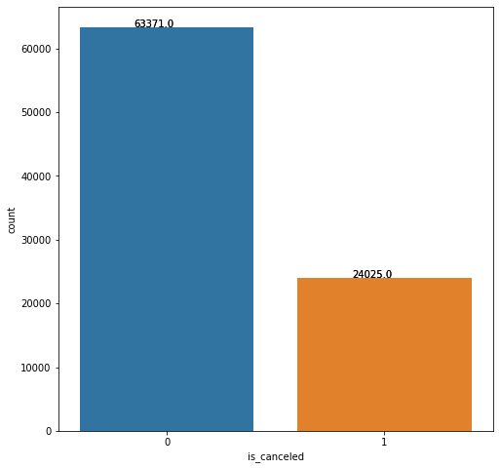
2)Cancelled bookings
We can clearly seen that amongst the total booking count of cancelled booking is 44224 which is 27.48 % of total booking

Slide 11
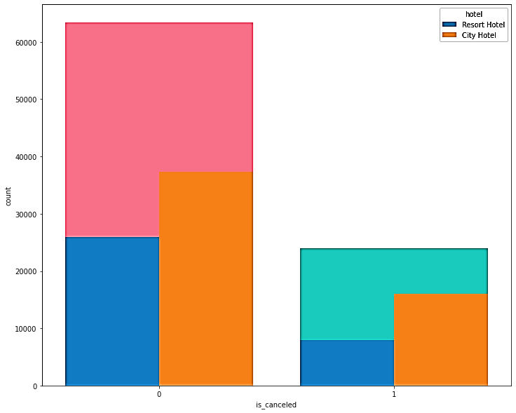
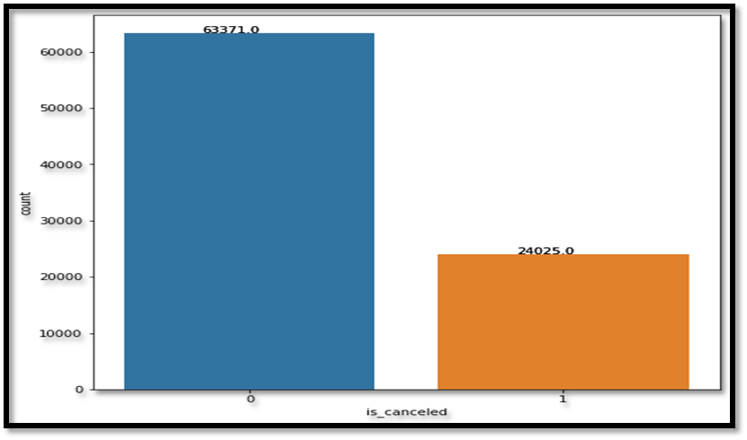
2)Cancelled bookings
We can have deeper look into a data then we can realized the booking from which Hotel category has more confirm booking and cancellation coming from
City hotels have max number of cancellation.

Slide 12
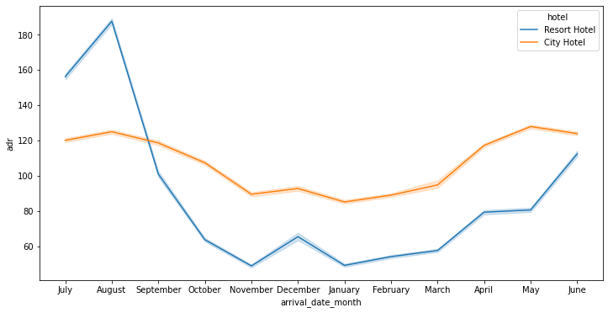
3)Average Daily Rate (ADR) :- dividing the sum of all lodging transactions by the total number of staying nights
1.Blue margin indicates Resort Hotel .
2.Red margin indicates City Hotel.
3.Resort hotels, the average daily rate is more expensive during august, july and september.
4.For city hotels, the average daily rate is more expensive during august,jully, june and may.
The average daily rate (ADR) shows how much revenue is made per room on average. The higher the ADR, the better. A rising ADR suggests that a hotel is increasing the money it's making from renting out rooms.

Slide 13
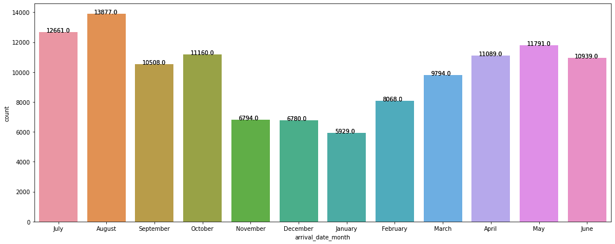
4)Now lets check the arrival date by months
a. The arrivals of customers is more in the month of August and next month with more numbers of
arrivals was in the month of July comparatively less arrivals in other months .
In the month of august the number of arrivals are more than 10,000.
In the month of July the arrivals are equal to 12663
The number of arrivals were even good in number in the month of September, October, march,
april, may, June.

Slide 14
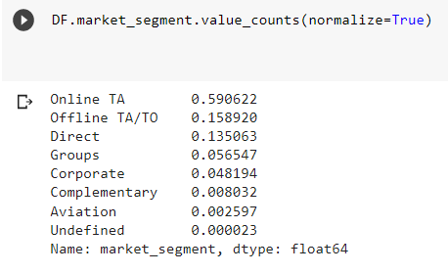
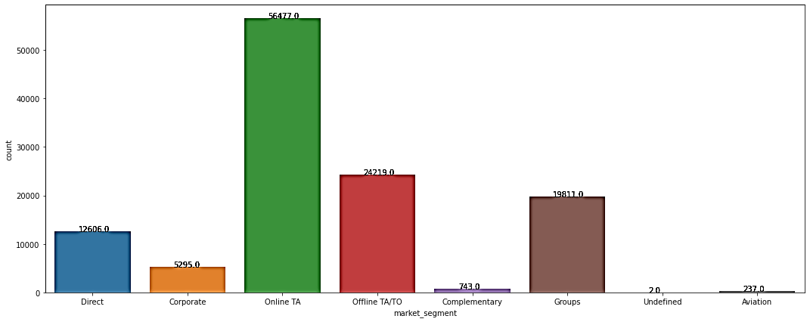
5)Market Segment
Lets check the Market segment designation. In categories, the term “TA” means “Travel Agents” and “TO” means “Tour Operators”.
When hotels collaborate effectively with online TA they reduce their inventories of uncooked rooms and boost revenue .
Compared to other market segment designation online TA is high in range.
With 56477.

Slide 15
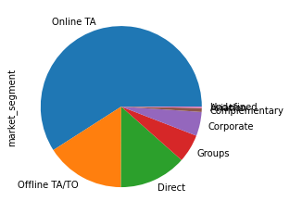
Market Segment
The market segment graph follows below pattern
Online TA (travel Agent) – 59 %
Offline TA/TO - 15 %
Direct booking - 13 %
Total more than 87% booking are happening from above three mode only

Slide 16
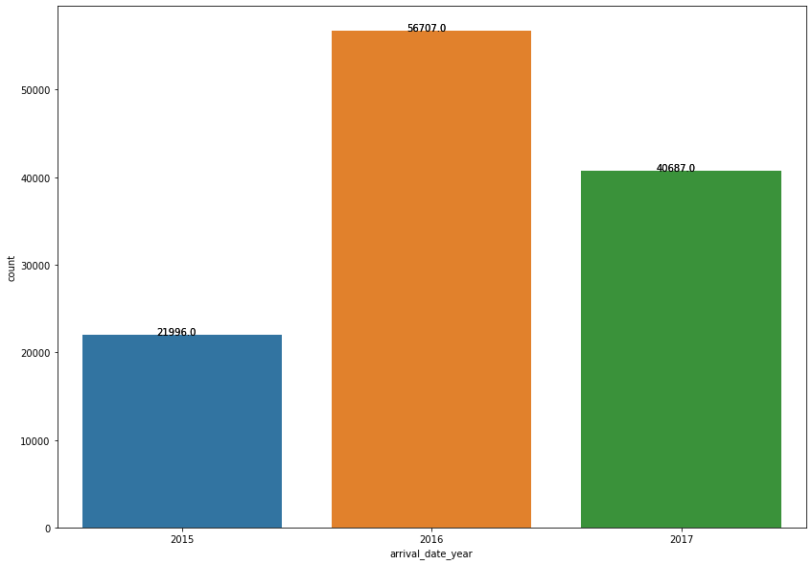
6) Year of arrival date
a. The number of arrivals in the year of 2016 is high with 56707 and the next year in 2017 is 40667
b. In 2015 there were few number of arrivals with less than 21996.

Slide 17
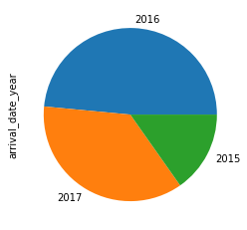
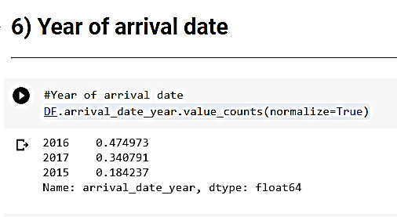
Year of arrival date
In 2016 - 47 %
In 2017 - 34 %
In 2015 - 18 %

Slide 18
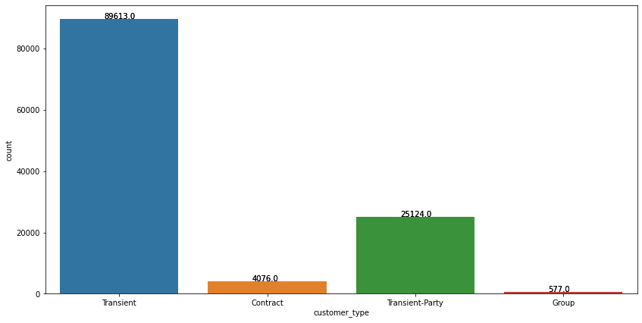
7)Customer Type
Type of booking, assuming one of four categories:
a)Contract - when the booking has an allotment or other type of contract associated to it;
b)Group – when the booking is associated to a group;
c)Transient – when the booking is not part of a group or contract, and is not associated to other transient booking;
d)Transient-party – when the booking is transient, but is associated to at least other transient booking

Slide 19
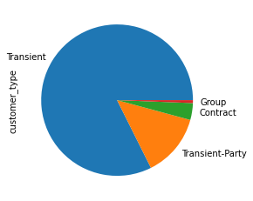
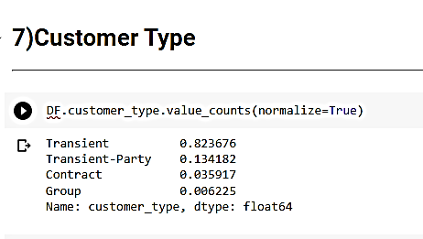
Customer Type
Transient - 82.36 %
Transient-Party - 13.41 %
Contract - 3.59 %
Group - 0.62%

Slide 20
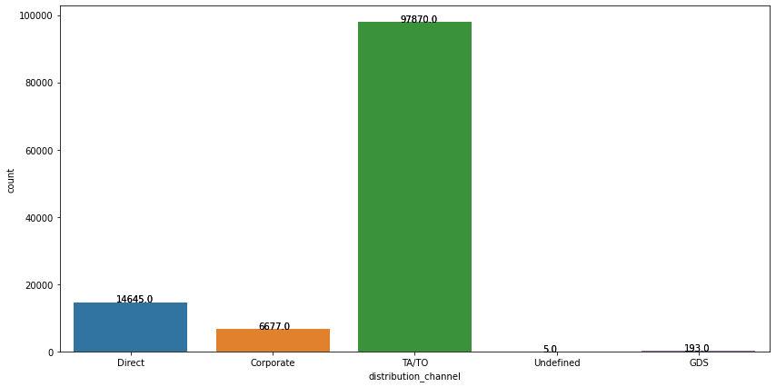
8)Distribution Channel
Booking distribution channel. The term “TA” means “Travel Agents” and “TO” means “Tour Operators”
The count of TA/TO distribution channel is 97870 of total distribution
Least is GDS,Undefined and corporates
.

Slide 21
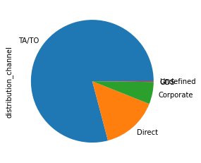
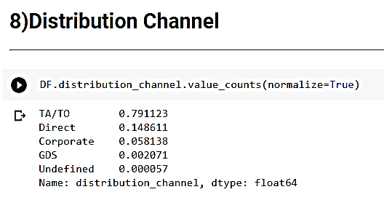
Distribution Channel
Booking distribution channel. The term “TA” means “Travel Agents” and “TO” means “Tour Operators”
The distribution channel of TA/TA is with a of 79 % .

Slide 22
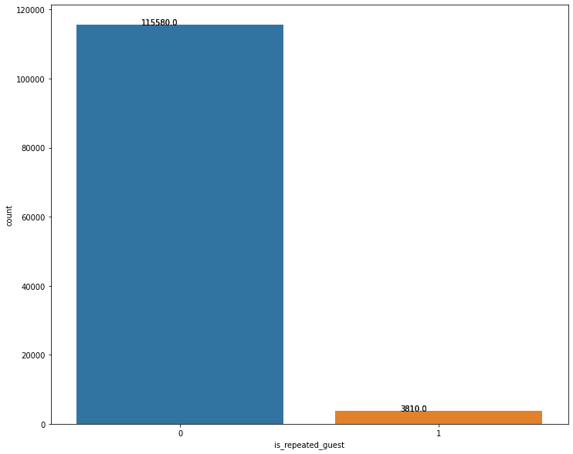
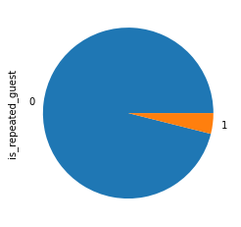
9)Repeated Guest
Check if the booking name was from a repeated guest or not
The count of 3810 customer have repeated
And more number of customer will not be repeated
Check if the booking name was from a repeated guest (1) or not (0)

Slide 23
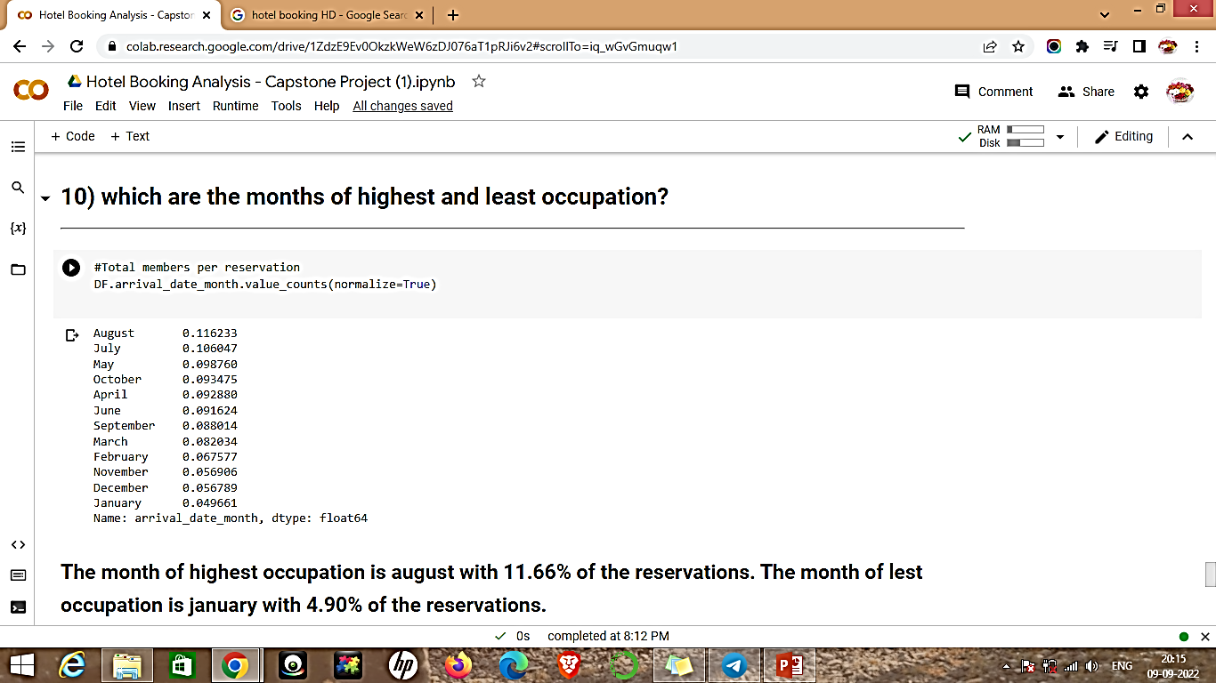
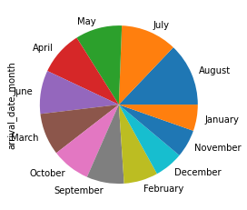
10) which are the months of highest and least occupation?
The month of highest occupation is august with 11.62 % of the reservations.
The month of lest occupation is january with 4.90 % of the reservations.

Slide 24
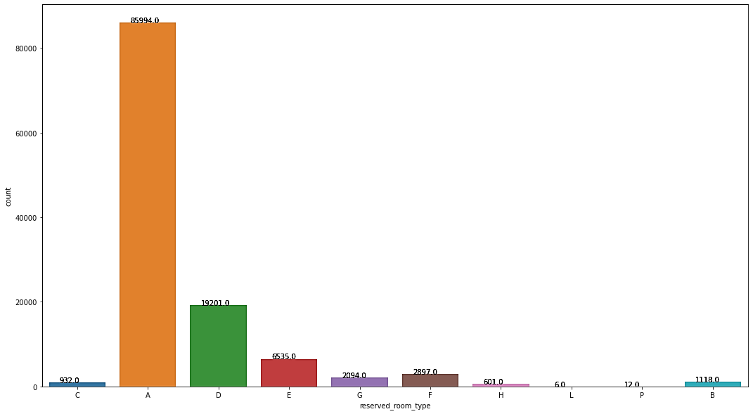
11)Which is the most reserved room type?
The most of reserved room by customer is type A category which is 72 %
The second on this list is category D which is 16 %

Slide 25
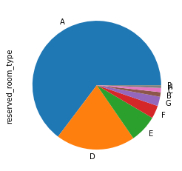
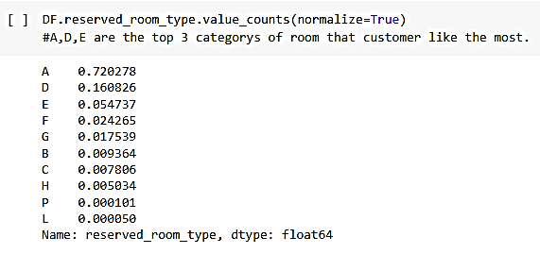
Which is the most reserved room type?
The most of reserved room by customer is type A category which is 72 %
The second on this list is category D which is 16 %
Third 5.4 % E type

Slide 26
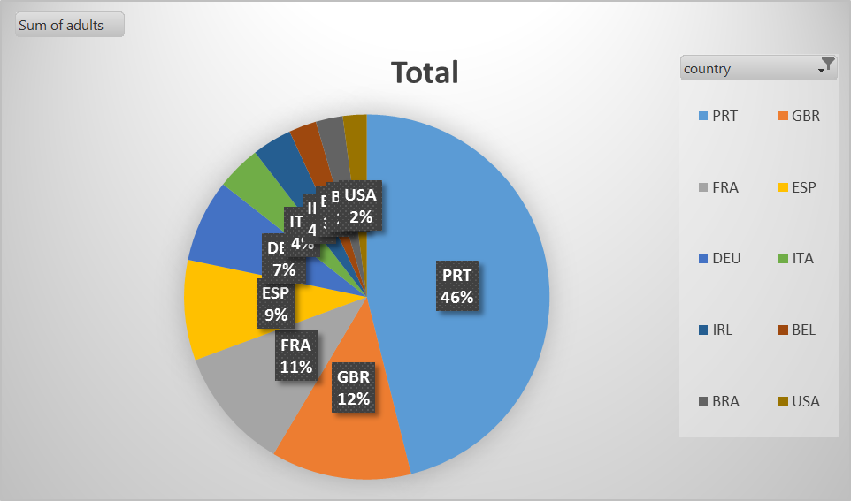
Which is the most visited customer from which country?

Slide 27
Conclusion
City hotel got most of booking in last three years of time span.
During the year, we have a 27.48% of cancelations.in that city hotels boking cancellation is more than resort hotel
Resort hotels, the average daily rate is more expensive during august, July and September.
For city hotels, the average daily rate is more expensive during august,jully, june and may.
The arrivals of customers is more in the month of August and next month with more numbers of arrivals was in the month of July comparatively less arrivals in other months .
Compared to other market segment designation online TA is high in range. With 56477.
The number of arrivals in the year of 2016 is high with 56707 and the next year in 2017 is 40667
The frequency of customer repetition was low hotel need to have opportunity in that area where they can make improvements
The month of highest occupation is august with 11.62 % of the reservations. The month of lest occupation is January with 4.90 % of the reservations.
The most of reserved room by customer is type A category which is 72 %

Slide 28
Thank you

